Slide 1

PROJECT Title Analyzing the Impact of Cloud Computing on Business Efficiency and Scalability
Submitted in partial fulfillment of the requirements for the award of the degree of Master of Computer Application (MCA) By
Student Name: Nilesh Kumar Sahu
Enrollment No: O24MCA111831
Under the guidance of Guide/Mentor Name: Vasanthi Chandran

Slide 2
Abstract / Executive Summary
Project Topic Overview
Objectives: Investigate cloud-driven cost structures , analyze long-term scalability mechanisms , evaluate security risks , and map sector-specific adoption patterns.
System Analysis & Design: Evaluates the five essential cloud characteristics , utilizes a structured PRISMA research methodology , and triangulates qualitative literature with quantitative market benchmarks.
Implementation & Testing: Documents a 15–50% cost reduction , weeks-to-minutes deployment times , a 69% reduction in downtime , and compliance validation against GDPR/HIPAA standards.
Future Scope: Explores AI-cloud convergence to cut operational overhead by 80% , edge computing paradigms processing 75% of data by 2030 , serverless maturation , and quantum cloud environments.

Slide 3
Introduction
Project Background
Foundational Shift: Cloud computing has evolved from a basic technological convenience into a critical strategic business imperative across global industries.
Market Expansion: The global cloud ecosystem is experiencing massive, non-cyclical growth, with expenditures estimated at USD 1.3 trillion in 2025.
Core Drivers: Driven by the intense corporate need for immediate operational agility, cost structure optimization, and rapid digital scaling capabilities.
Resource Revolution: Replaces restrictive legacy data centers with on-demand, internet-based utility computing on a flexible pay-as-you-go consumption model.
Universal Adoption: An estimated 98% of contemporary enterprises utilize cloud technology, with 89% actively executing sophisticated multi-cloud strategies.

Slide 4
System Study
Existing System
Limitations
High Upfront Costs which requires heavy upfront capital expenditure
Resource Waste during low-traffic periods
Operational Inflexibility in which deployment takes weeks or months
Feasibility Study
Financial Viability as Shifting to a pay-as-you-go
Cloud architectures enable elastic, theoretically unlimited horizontal scaling to handle sudden demand spikes
Requirement Gathering
Needs a clear framework spanning Infrastructure (IaaS), Platform (PaaS), and Software (SaaS) service models
Requires automated technical mechanisms like auto-scaling, load balancing, and container orchestration.

Slide 5
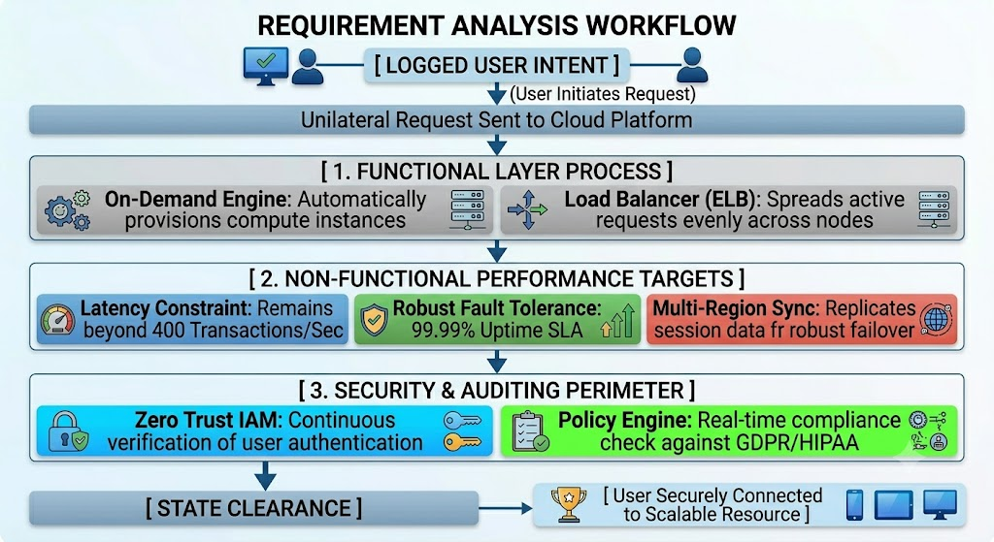
System Analysis
Requirement Analysis
Functional Requirements
Non-Functional Requirements

Slide 6
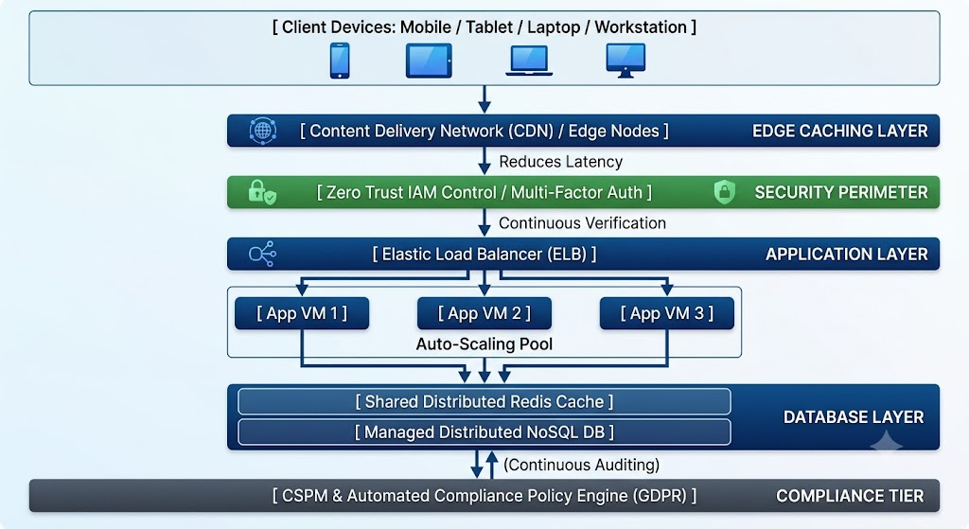
System Design
System Architecture
Database Design
Stateless Application Architecture, Distributed Scalability Tier, Data Security at Rest

Slide 7
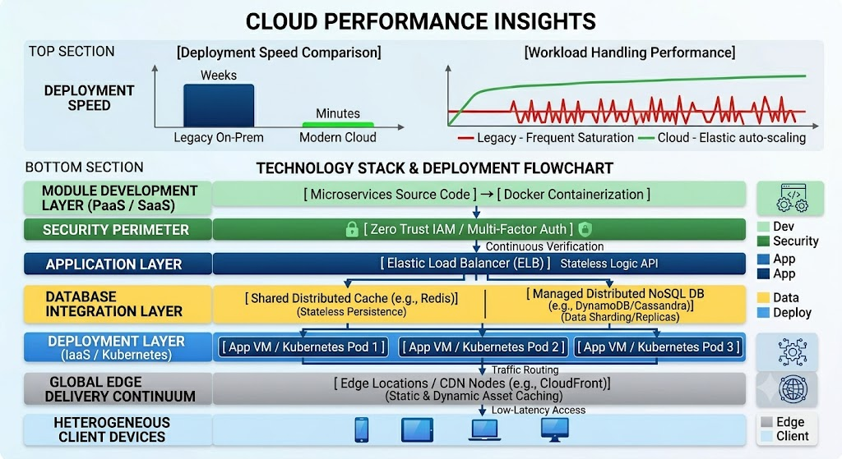
System Implementation

Slide 8
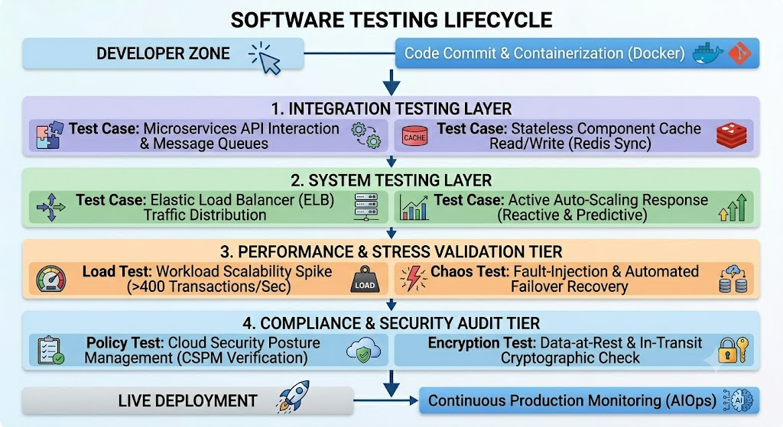
Testing

Slide 9
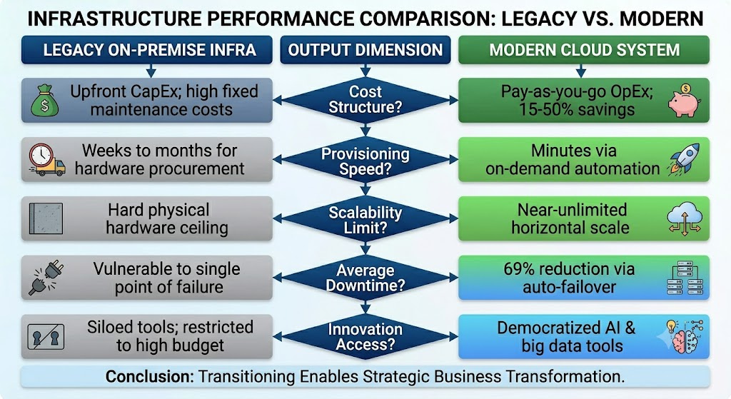
Results & Discussion

Slide 10
Conclusion & Future Scope
Project Summary
Objectives Achieved
Successfully mapped the conceptual foundations, service models, and architecture patterns of hyperscale computing
Successfully analyzed and validated operational performance metrics through major global enterprise case studies
Benefits
Cost Structure Optimization, Operational Tempo Acceleration and Resilient Infrastructure Architecture
Future Enhancements
Embedding dedicated AI operational models (AIOps) to reduce human monitoring overhead by up to 80%.
Transitioning to dense decentralized networks to handle local real-time processing demands, with 75% of global data moving to the network edge by 2030.

Slide 11
Thank you….

